Slide 1

Day 4 – 4:00 Project Progress Report -Tympe-
Logan Schlick, Daniel Marin, Kyle Rimando, Sonny Pizzo, Shane Ghuste

Slide 2
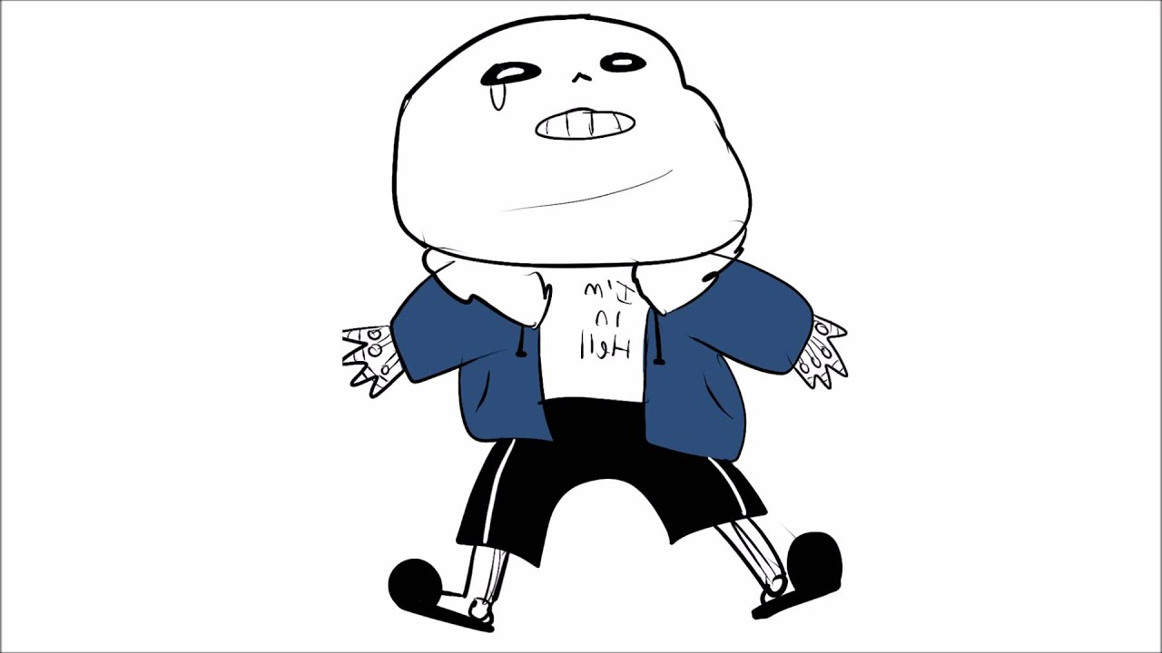
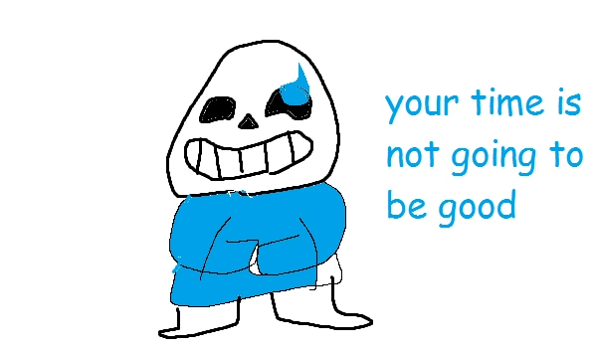
Front end progress…
Finished the website
Added hard and easy mode
Front end designers:
Daniel Marin
Sonny Pizzo

Slide 3
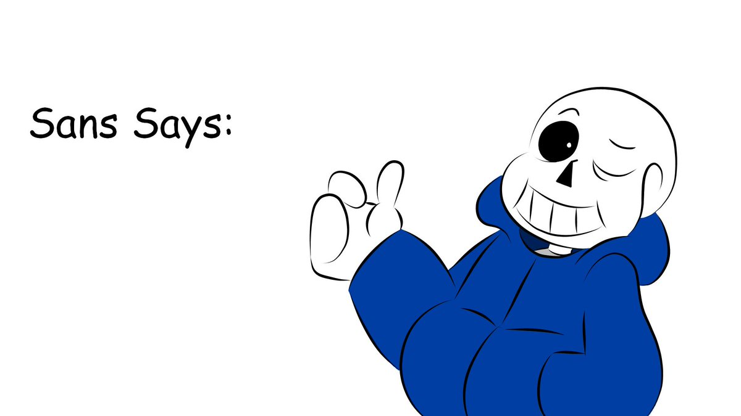
Back end progress…
Created coding for easy and hard mode.
Finished full coding for game
Code for the rest of your existence
Back end designers:
Logan Schlick
Kyle Rimando

Slide 4
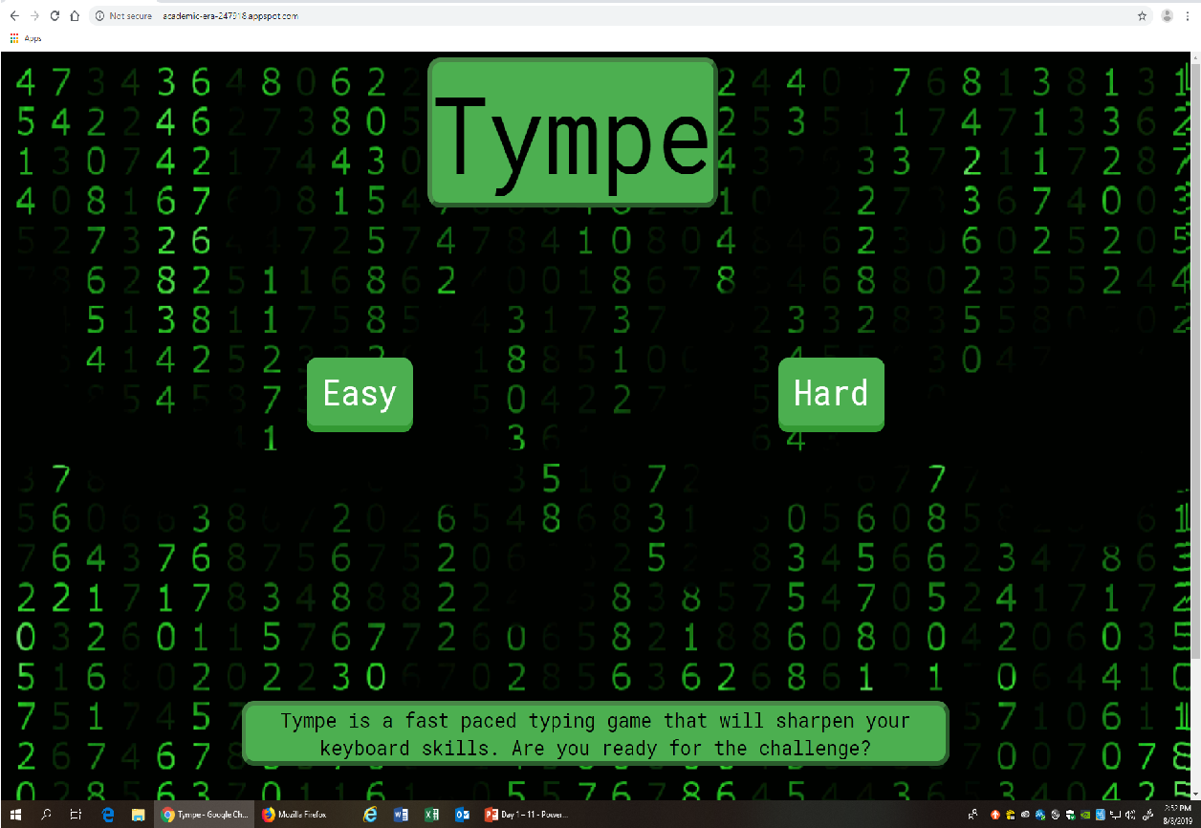
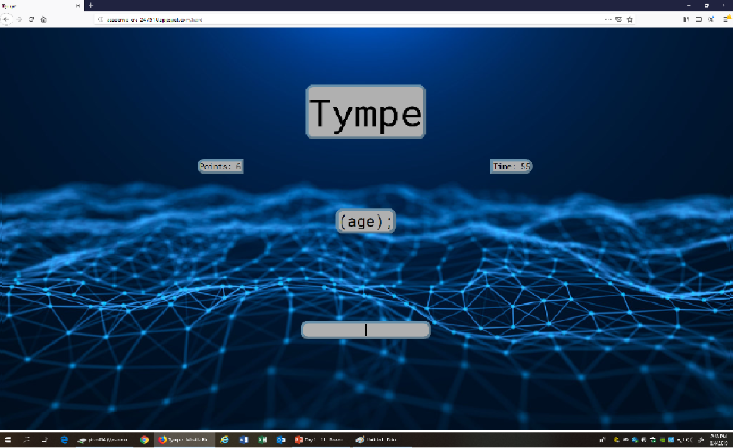
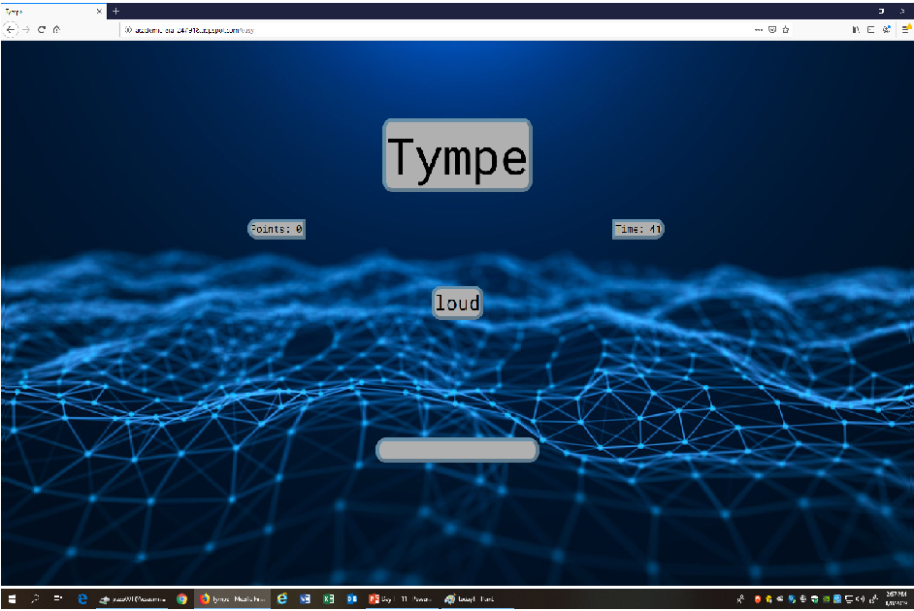
Hard Mode
Easy Mode

